Slide 1


Introduction to Streaming
using

Slide 2
What is Streaming?
Data is generated continuously from one or many sources
Sources typically send in data simultaneously
Data comes in small packages (kilobyte scale) in succession

Slide 3
Why use Streaming?
A lot of applications use continuously-updated data
Examples:
Sensors in vehicles, industrial equipment, and machinery send data to streaming for performance measurement.
A website tracking geo-location data from customer’s phones, which is gathered by streaming, so the website can make recommendations of which restaurants to visit
Solar power company monitoring panel performance through streaming
Online gaming company collecting streaming data about player-game interactions
Notes:
reduceByKeyAndWindow(func, windowLength, slideInterval, [numTasks])
When called on a DStream of (K, V) pairs, returns a new DStream of (K, V) pairs where the values for each key are aggregated using the given reduce function func over batches in a sliding window. Note: By default, this uses Spark's default number of parallel tasks (2 for local mode, and in cluster mode the number is determined by the config property spark.default.parallelism) to do the grouping. You can pass an optional numTasks argument to set a different number of tasks
reduceByKeyAndWindow(func, invFunc, windowLength, slideInterval, [numTasks])
A more efficient version of the above reduceByKeyAndWindow() where the reduce value of each window is calculated incrementally using the reduce values of the previous window. This is done by reducing the new data that enters the sliding window, and “inverse reducing” the old data that leaves the window. An example would be that of “adding” and “subtracting” counts of keys as the window slides. However, it is applicable only to “invertible reduce functions”, that is, those reduce functions which have a corresponding “inverse reduce” function (taken as parameter invFunc). Like in reduceByKeyAndWindow, the number of reduce tasks is configurable through an optional argument. Note that checkpointing must be enabled for using this operation.

Slide 4
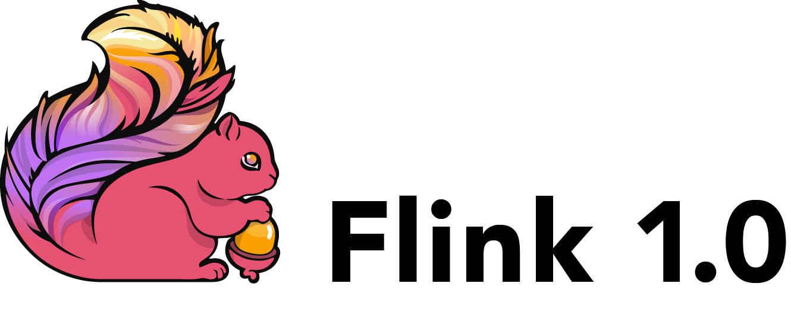




Popular Streaming Tools
Storm
Flink
Kinesis
Samza
Kafka
Apache Spark
Notes:
reduceByKeyAndWindow(func, windowLength, slideInterval, [numTasks])
When called on a DStream of (K, V) pairs, returns a new DStream of (K, V) pairs where the values for each key are aggregated using the given reduce function func over batches in a sliding window. Note: By default, this uses Spark's default number of parallel tasks (2 for local mode, and in cluster mode the number is determined by the config property spark.default.parallelism) to do the grouping. You can pass an optional numTasks argument to set a different number of tasks
reduceByKeyAndWindow(func, invFunc, windowLength, slideInterval, [numTasks])
A more efficient version of the above reduceByKeyAndWindow() where the reduce value of each window is calculated incrementally using the reduce values of the previous window. This is done by reducing the new data that enters the sliding window, and “inverse reducing” the old data that leaves the window. An example would be that of “adding” and “subtracting” counts of keys as the window slides. However, it is applicable only to “invertible reduce functions”, that is, those reduce functions which have a corresponding “inverse reduce” function (taken as parameter invFunc). Like in reduceByKeyAndWindow, the number of reduce tasks is configurable through an optional argument. Note that checkpointing must be enabled for using this operation.

Slide 5
To the Code!

